Slide 1
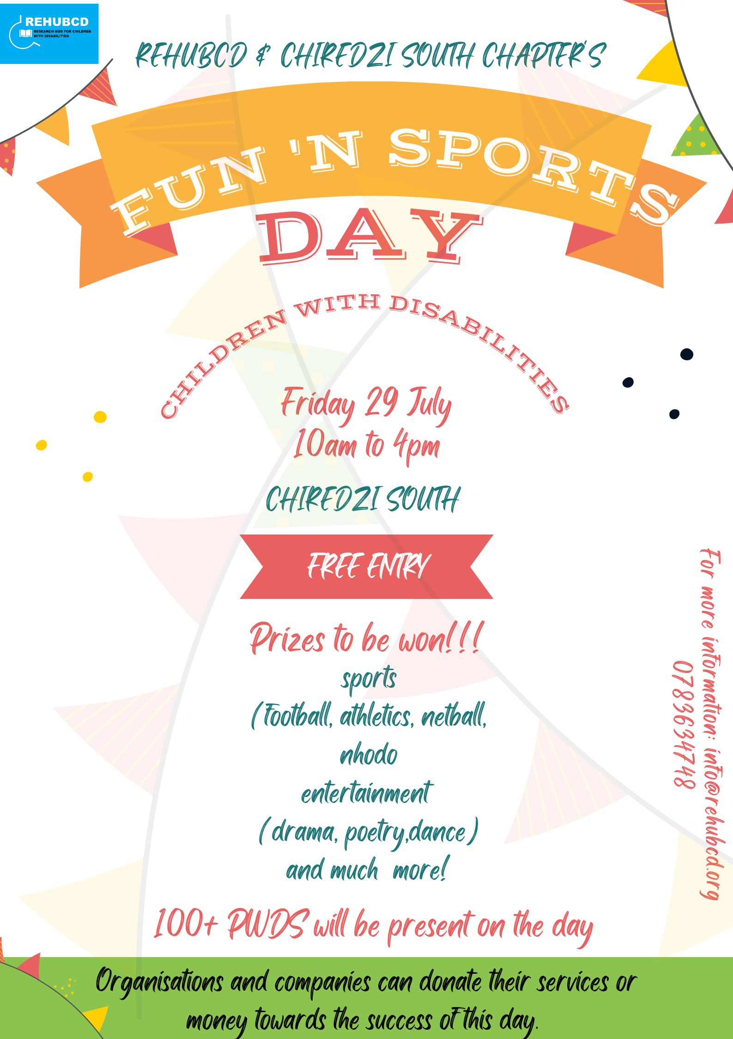

Slide 2
MAIN ACTIVITIES
Soccer- 5 are side
Nhodo-4 players
Poetry competition -4 students
Dancing competition -3 dancers
Tree climbing – 1 person
Plank charging socket- 1 person

Slide 3
Dr OLIVIA GUMBO SPEECH
-Recognised the gifts and talents that people with disabilities have and encouraged them to showcase their talents
-All people are created in God’s image and have human rights
-Challenged schools to start Paralympics in the constituency by giving two floating trophies
-Thanked all partners who offered money, clothes, stationery and labour for the day to be a success

Slide 4
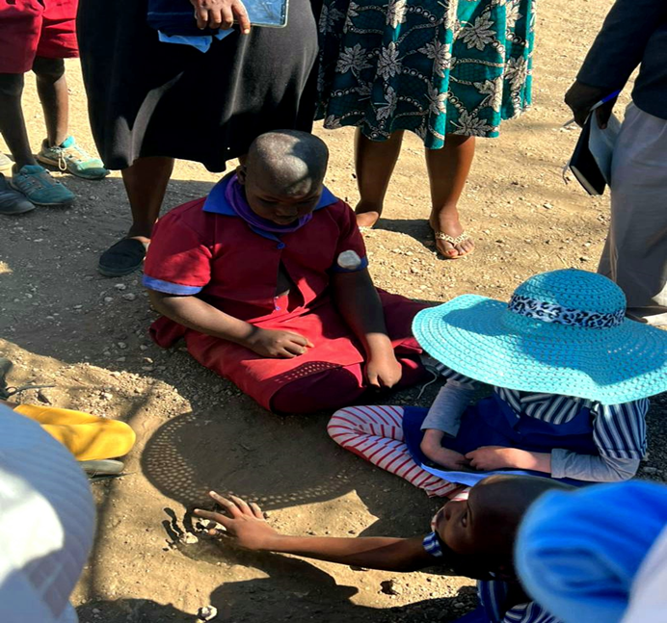
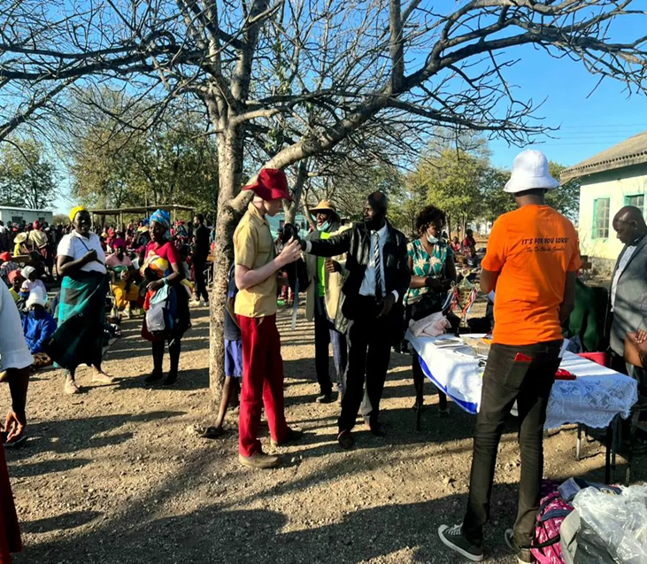
Nhodo and Poetry competitions
Nhodo-Tichadya Primary school won
Poetry-Boli Primary school won

Slide 5
COMPETITION 3 (Soccer)
Two teams from various schools were created.
Each team had five players.
The game was 20mins
Majijimba Primary school won with one goal.
Soccer match

Slide 6
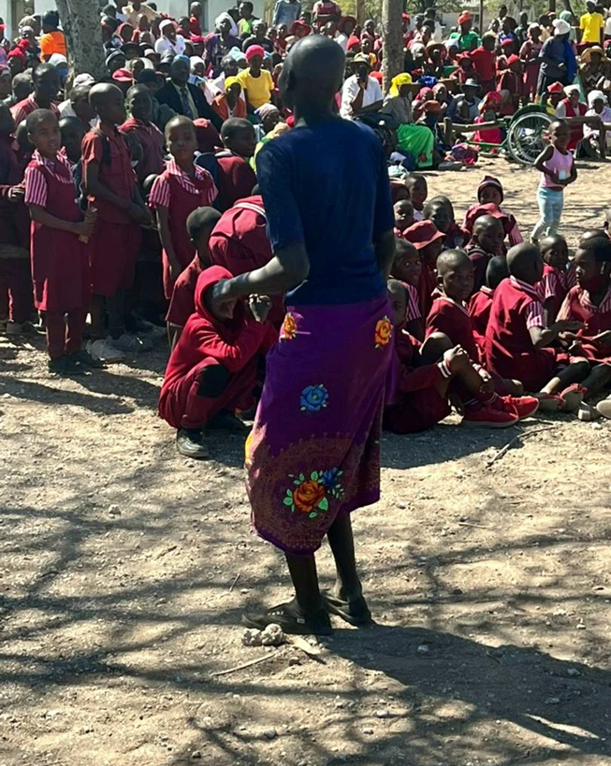
TREE CLIMBING
Dance-Majijimba primary won
This was an interesting game as different schools having children with disabilities show cased their skills in climbing trees.
Chiteya Primary school won this competition

Slide 7
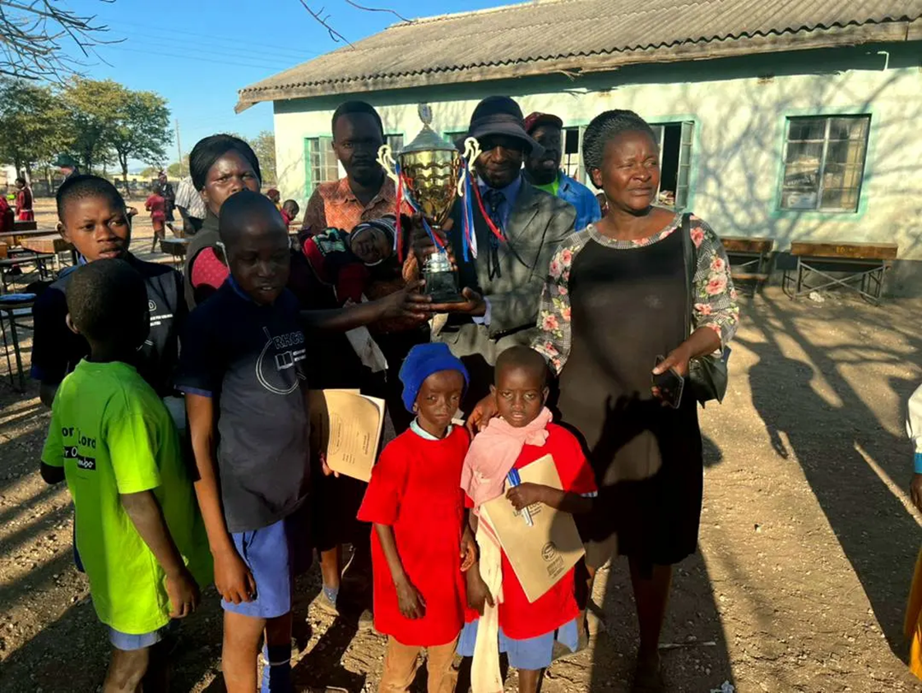
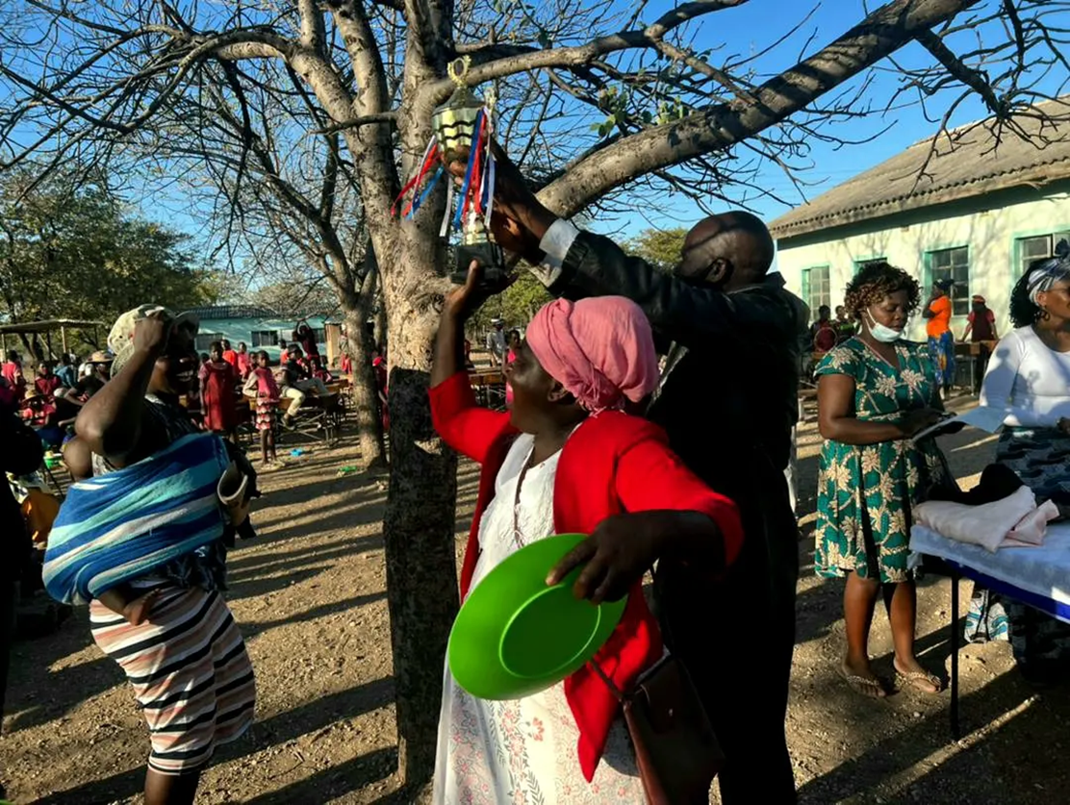
Paralympic trophies
WINNER: MAJIJIMBA PRIMARY SCHOOL
SECOND PLACE: CHITEYA PRIMARY SCHOOL

Slide 8
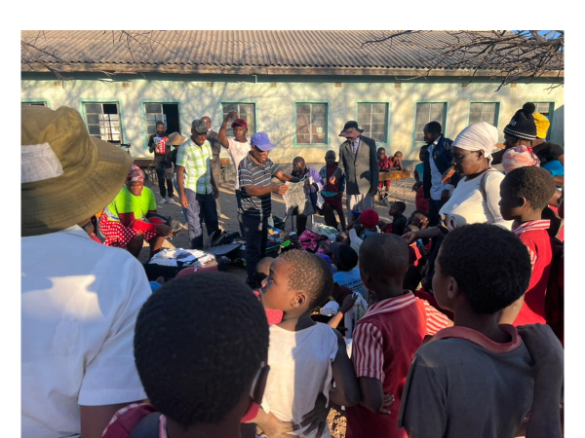
CHIREDZI SOUTH DONATIONS
After the prize giving ceremony, Chiredzi south residents were given donations.
There were a lot of bags with clothes and shoes.
Bags for women and girls' clothes and shoes.
Men and boys' clothes and shoes.
The committee assisted in sharing the clothes which was done on the spot to foster transparency.

Slide 9
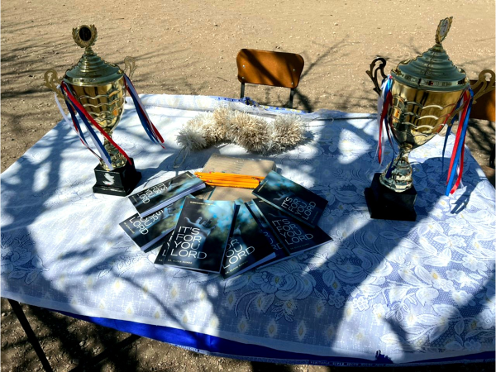
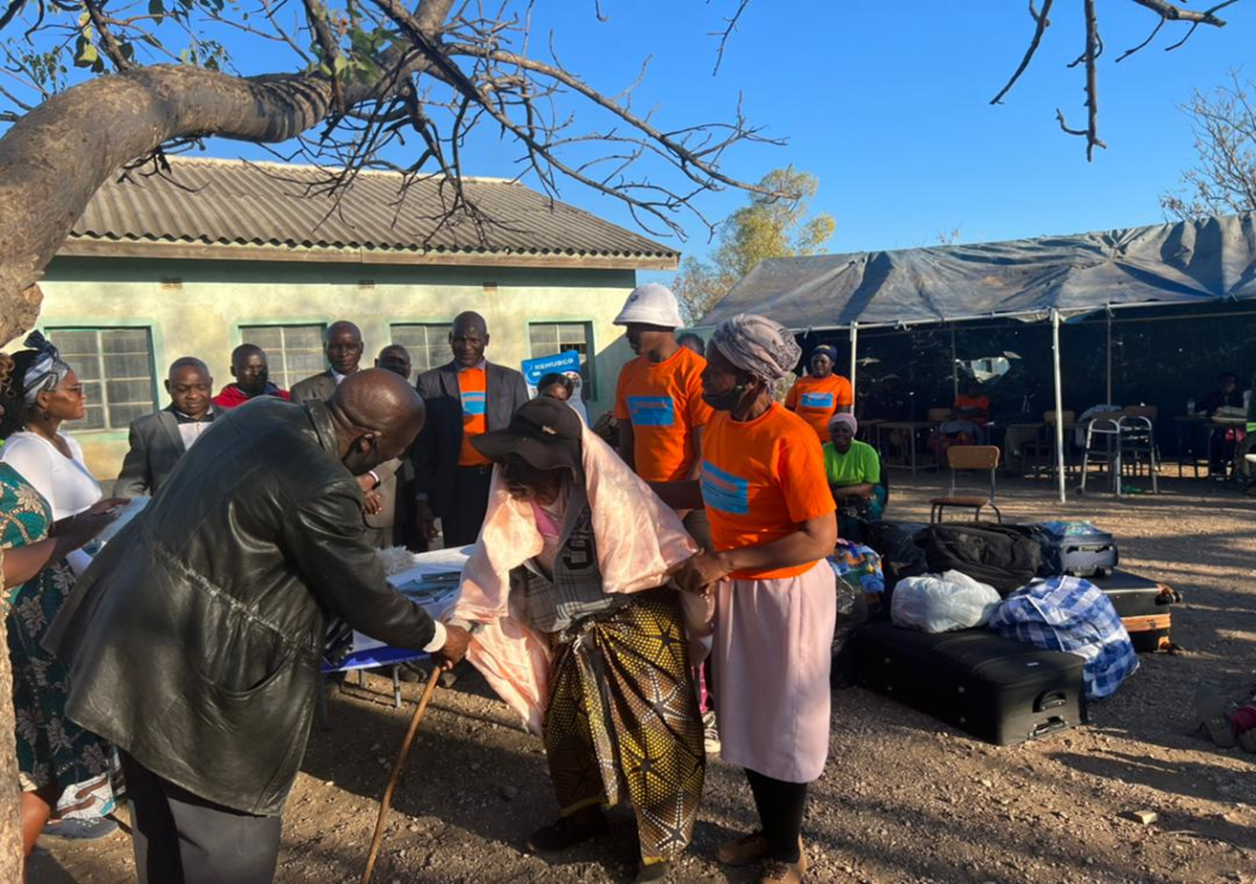
Thank you
Trophies
107-year old woman

